Slide 1
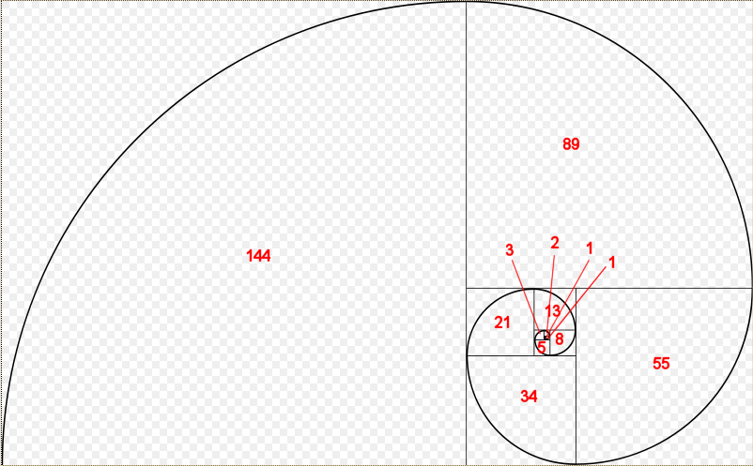
Fibonacci Counter
Notes:
The picture above illustrate a spiral that connect opposite end in each box. This pattern of spiral is call the golden spiral. http://en.wikipedia.org/wiki/Golden_spiral

Slide 2
Goal
Design a Five bit Fibonacci counter
2⁵= 32bit size
Count sequence 0, 1, 1, 2, 3, 5, 8, 13, 21…

Slide 3
Truth Table
Q1 | Q2 | Q3 | Q4 | Q5 |  |  | Q1⁺ | Q2⁺ | Q3⁺ | Q4⁺ | Q5⁺
0 | 0 | 0 | 0 | 0 |  |  | 0 | 0 | 0 | 0 | 1
0 | 0 | 0 | 0 | 1 |  |  | 0 | 0 | 0 | 1 | 0
0 | 0 | 0 | 1 | 0 |  |  | 0 | 0 | 0 | 1 | 1
0 | 0 | 0 | 1 | 1 |  |  | 0 | 0 | 1 | 0 | 1
0 | 0 | 1 | 0 | 1 |  |  | 0 | 1 | 0 | 0 | 0
0 | 1 | 0 | 0 | 0 |  |  | 0 | 1 | 1 | 0 | 1
0 | 1 | 1 | 0 | 1 |  |  | 1 | 0 | 1 | 0 | 1
1 | 0 | 1 | 0 | 1 |  |  | 0 | 0 | 0 | 0 | 0
Notes:
Did not use in actual design

Slide 4
K-Map
Q1⁺ | Q3,Q4,Q5
Q1,Q2 |  | 000 | 001 | 011 | 010 |  | 110 | 111 | 101 | 100
 | 00 | 0 | 0 | 0 | 0 |  | 0 | 0 | 0 | 0
 | 01 | 0 | 0 | 0 | 0 |  | 0 | 0 | 1 | 0
 | 11 | 0 | 0 | 0 | 0 |  | 0 | 0 | 0 | 0
 | 10 | 0 | 0 | 0 | 0 |  | 0 | 0 | 0 | 0
Q2⁺ | Q3,Q4,Q5
Q1,Q2 |  | 000 | 001 | 011 | 010 |  | 110 | 111 | 101 | 100
 | 00 | 0 | 0 | 0 | 0 |  | 0 | 0 | 1 | 0
 | 01 | 1 | 0 | 0 | 0 |  | 0 | 0 | 0 | 0
 | 11 | 0 | 0 | 0 | 0 |  | 0 | 0 | 0 | 0
 | 10 | 0 | 0 | 0 | 0 |  | 0 | 0 | 0 | 0
Q1⁺= ~Q1Q2Q3~Q4Q5
Q2⁺=(~Q1~Q2Q3~Q4Q5)+(~Q1Q2~Q3~Q4~Q5)
=(~Q1~Q4)((~Q2Q3Q5)+(Q2~Q3~Q5))
=(~Q1~Q4)(Q2 XOR Q3 XOR Q5)
Q3⁺ | Q3,Q4,Q5
Q1,Q2 |  | 000 | 001 | 011 | 010 |  | 110 | 111 | 101 | 100
 | 00 | 0 | 0 | 1 | 0 |  | 0 | 0 | 0 | 0
 | 01 | 1 | 0 | 1 | 0 |  | 0 | 0 | 0 | 0
 | 11 | 0 | 0 | 0 | 0 |  | 0 | 0 | 0 | 0
 | 10 | 0 | 0 | 0 | 0 |  | 0 | 0 | 0 | 0
Q3⁺= (~Q1~Q3Q4Q5)+(~Q1Q2~Q3~Q4~Q5)
= (~Q1~Q3)((Q4Q5)+(~Q3~Q4~Q5))
Notes:
Did not use in actual design

Slide 5
K-Map
Q4⁺ | Q3,Q4,Q5
Q1,Q2 |  | 000 | 001 | 011 | 010 |  | 110 | 111 | 101 | 100
 | 00 | 0 | 1 | 0 | 1 |  | 0 | 0 | 0 | 0
 | 01 | 0 | 0 | 0 | 0 |  | 0 | 0 | 0 | 0
 | 11 | 0 | 0 | 0 | 0 |  | 0 | 0 | 0 | 0
 | 10 | 0 | 0 | 0 | 0 |  | 0 | 0 | 0 | 0
Q4⁺= (~Q1~Q2~Q3~Q4Q5)+(~Q1~Q2Q3~Q4~Q5)
= (~Q1~Q2~Q4)(Q3 XOR Q5)
Q5⁺ | Q3,Q4,Q5
Q1,Q2 |  | 000 | 001 | 011 | 010 |  | 110 | 111 | 101 | 100
 | 00 | 1 | 0 | 1 | 1 |  | 0 | 0 | 0 | 0
 | 01 | 1 | 0 | 0 | 0 |  | 0 | 0 | 1 | 0
 | 11 | 0 | 0 | 0 | 0 |  | 0 | 0 | 0 | 0
 | 10 | 0 | 0 | 0 | 0 |  | 0 | 0 | 0 | 0
Q5⁺= (~Q1~Q3~Q4~Q5)+(~Q1~Q2~Q3Q4)+(~Q1Q2Q3~Q4Q5)
= (~Q1)((~Q3~Q4~Q5)+(~Q2~Q3Q4)+(Q2Q3~Q4Q5))
Notes:
Did not use in actual design

Slide 6
State Diagram
0
1
2
3
21
13
8
5

Slide 7
Verilog HDL Source code
module Fcount(ClkM,fn);
input ClkM;
output[4:0]
fn;
reg [4:0] fn;
always@(posedge ClkM)
begin
case(fn)
0:fn<=1;
1:fn<=2;
2:fn<=3;
3:fn<=5;
5:fn<=8;
8:fn<=13;
13:fn<=21;
21:fn<=0;
default:fn<=0;
endcase
end
endmodule

Slide 8
Verilog HDL Testbench code
module fcounttest;
reg CLKM;
wire[4:0] FN;
Fcount TL(CLKM,FN);
initial
begin
#200 $stop;
end
initial
begin
CLKM=0;
#1 forever
#10 CLKM=~CLKM;
endendmodule
Notes:
TL in the verilog code is use to identify the creator of the code. Suppose if someone use your source code and have no knowledge of how verilog work then that person will just copy the whole source code thus the incriminate their self.

Slide 9
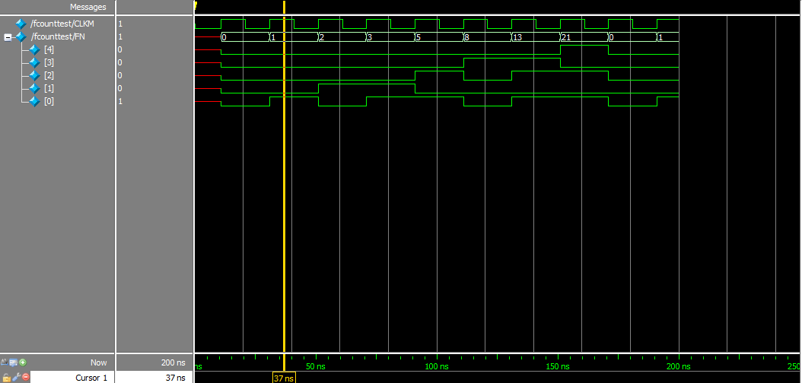
Waveform Output
Notes:
Red line in the waveform denote do not care “x” and Gold or Yellow line denote high “Z”. Note the Yellow horizontal line is not the “Z” it refer to a time reference for the user.

Slide 10

ISPLever Tutorial
To run ISPLever do the following:
Start > type in “isplever”
Open isplever

Slide 11
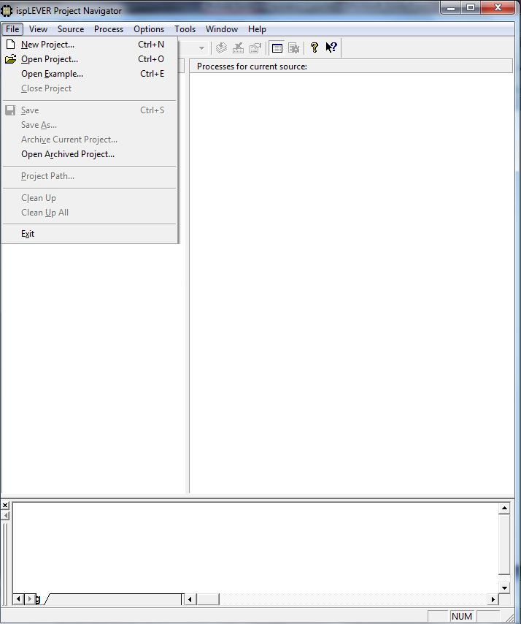
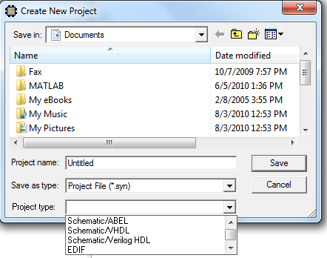
ISPLever Tutorial
Create a New Project
Name the Project and under Project type select “Schematic/Verilog HDL” and save project

Slide 12
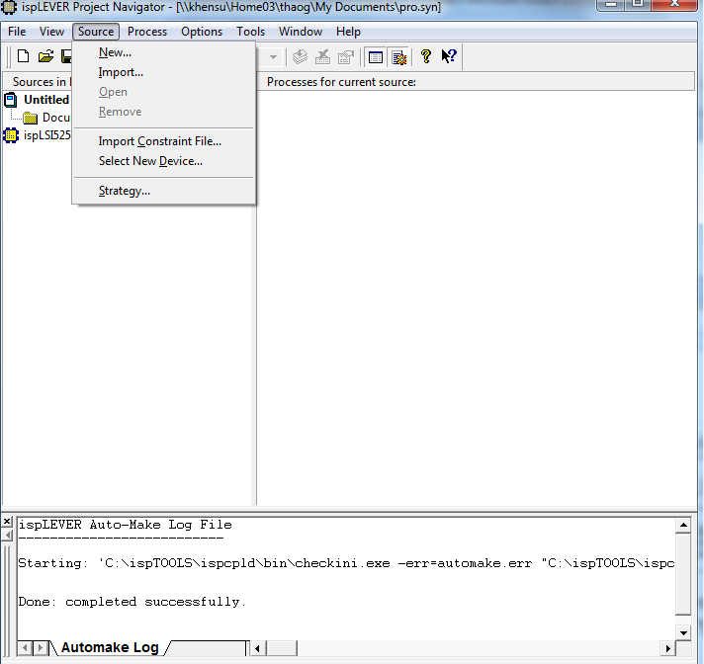
ISPLever Tutorial
In the Source Tab
Choose “Select New Device” to select device

Slide 13
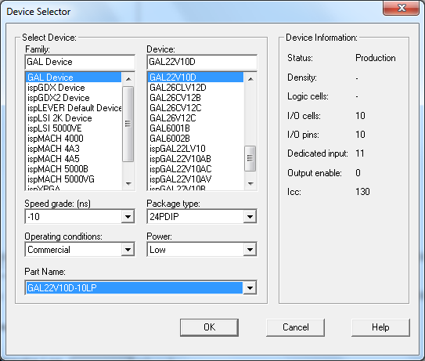
ISPLever Tutorial
In “Family” select the type of device being use
In “Device” select the series of the chip
In “Part Name” select the version of the chip
Click “OK” to finish
Two new window should popup asking for change in device. Click OK for both popup window.

Slide 14
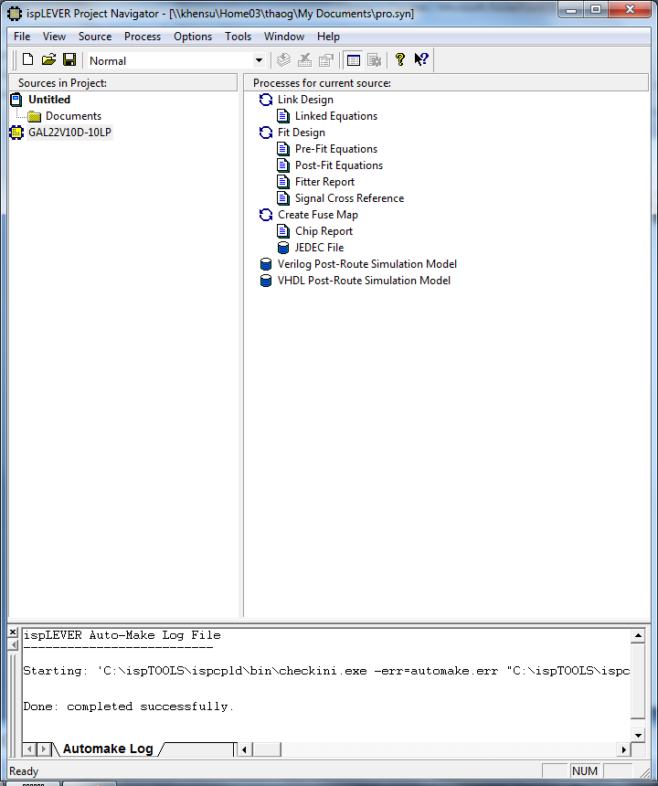
ISPLever Tutorial
Right click on the device and select import.
Import your source code

Slide 15
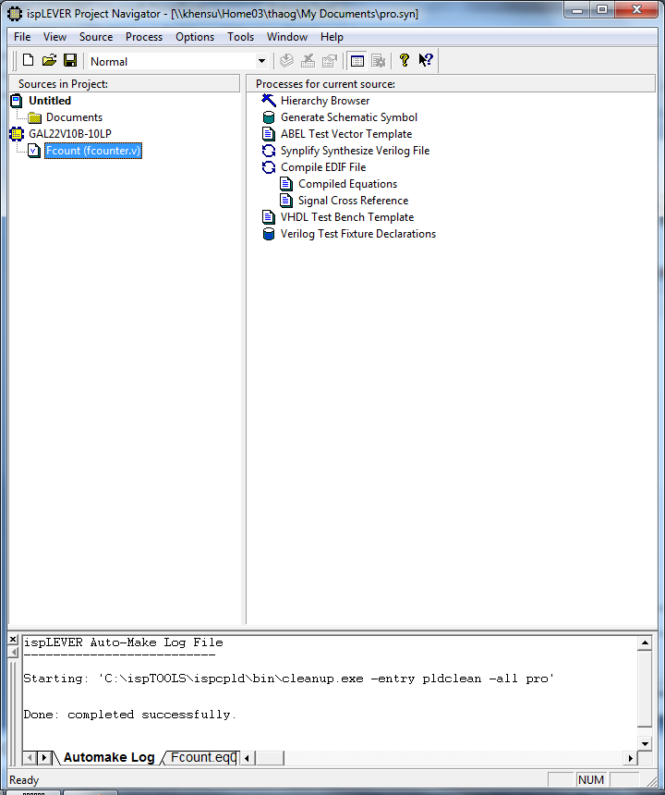
ISPLever Tutorial
Highlight your source code
On the right side of the window “Processes for current sources” double click on “Compiled Equations” to compile
On the bottom window is the log file when compile this window will show if the source code compile correctly or not with a green check.
If incorrect troubleshoot source code for bug.

Slide 16
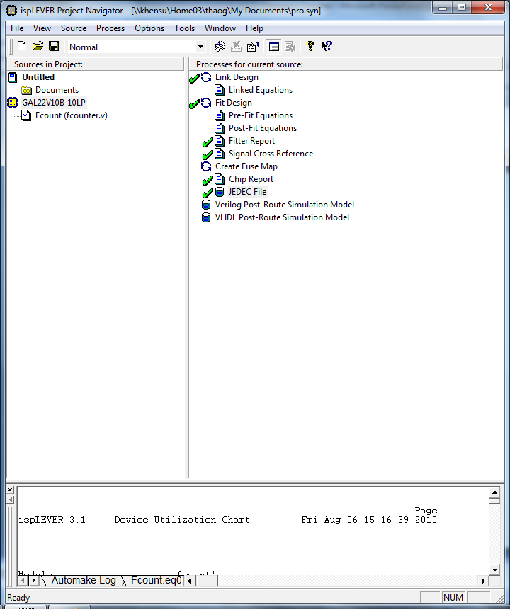
ISPLever Tutorial
Highlight the device
Double click on “JEDEC File” to create a JED file
Double click on “Chip Report”
In the bottom window after running chip report select all with your mouse and copy the report.
In notepad or word paste the report.
The chip report will give you a diagram layout your device

Slide 17
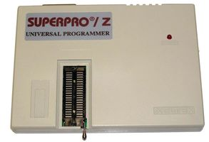
SuperPro Z Tutorial
Turn on the SuperPro Z Programmer by pushing on the rocker switch on the side of the device
Start > search> type in “superpro z”
Select SuperPro Z to open

Slide 18
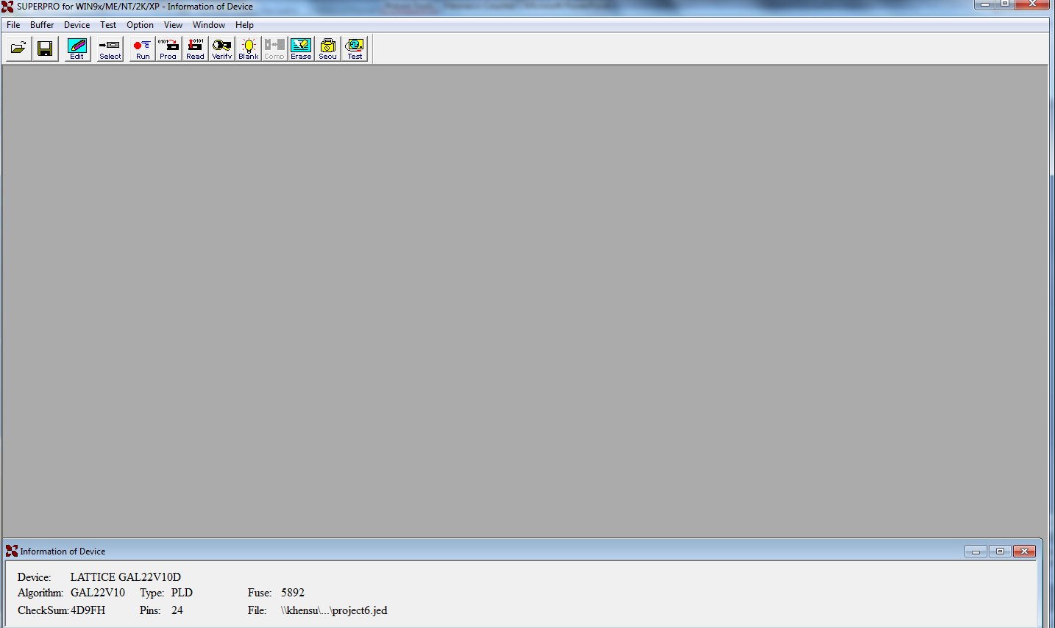
SuperPro Z Tutorial
In “Device” tab chose “select” to select chip

Slide 19
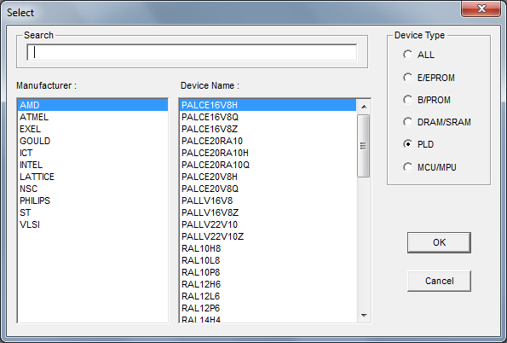
SuperPro Z Tutorial
Find the manufacture name and device name
If you do not know look up the datasheet of the device
Once the manufacture name and device is correctly enter click “ok”

Slide 20
SuperPro Z Tutorial
In the bottom window in SuperPro Z the device specification is listed
Under the “File” tab chose “load” and find the JED file that was save from ISPLever

Slide 21
SuperPro Z Tutorial
Insert the chip into the programmer by doing the following step:
Push the metal lever switch upward to allow the slot to accept the pins of the chip or remove the pins depend on what action user is performing
Indication on left side of the device show how the chip reset.
The pins first fill in the closet slot toward the user and then extend away from the user
Push the metal lever downward lock in the chip.
LED indicate power of device

Slide 22
SuperPro Z Tutorial
Click on “Prog” icon to program the chip

Slide 23
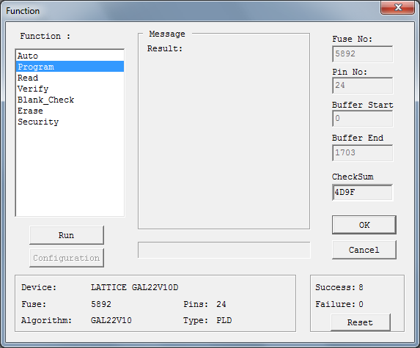
SuperPro Z Tutorial
The follow step occur in the Programming:
Device is erase
Pins and connections are created within the device
Once the programming is done

Slide 24
Hardware
One GAL22V10D-10LP
Five LED
Power supply 5VDC
Function Generator 1Hz square wave
Resistor

Slide 25
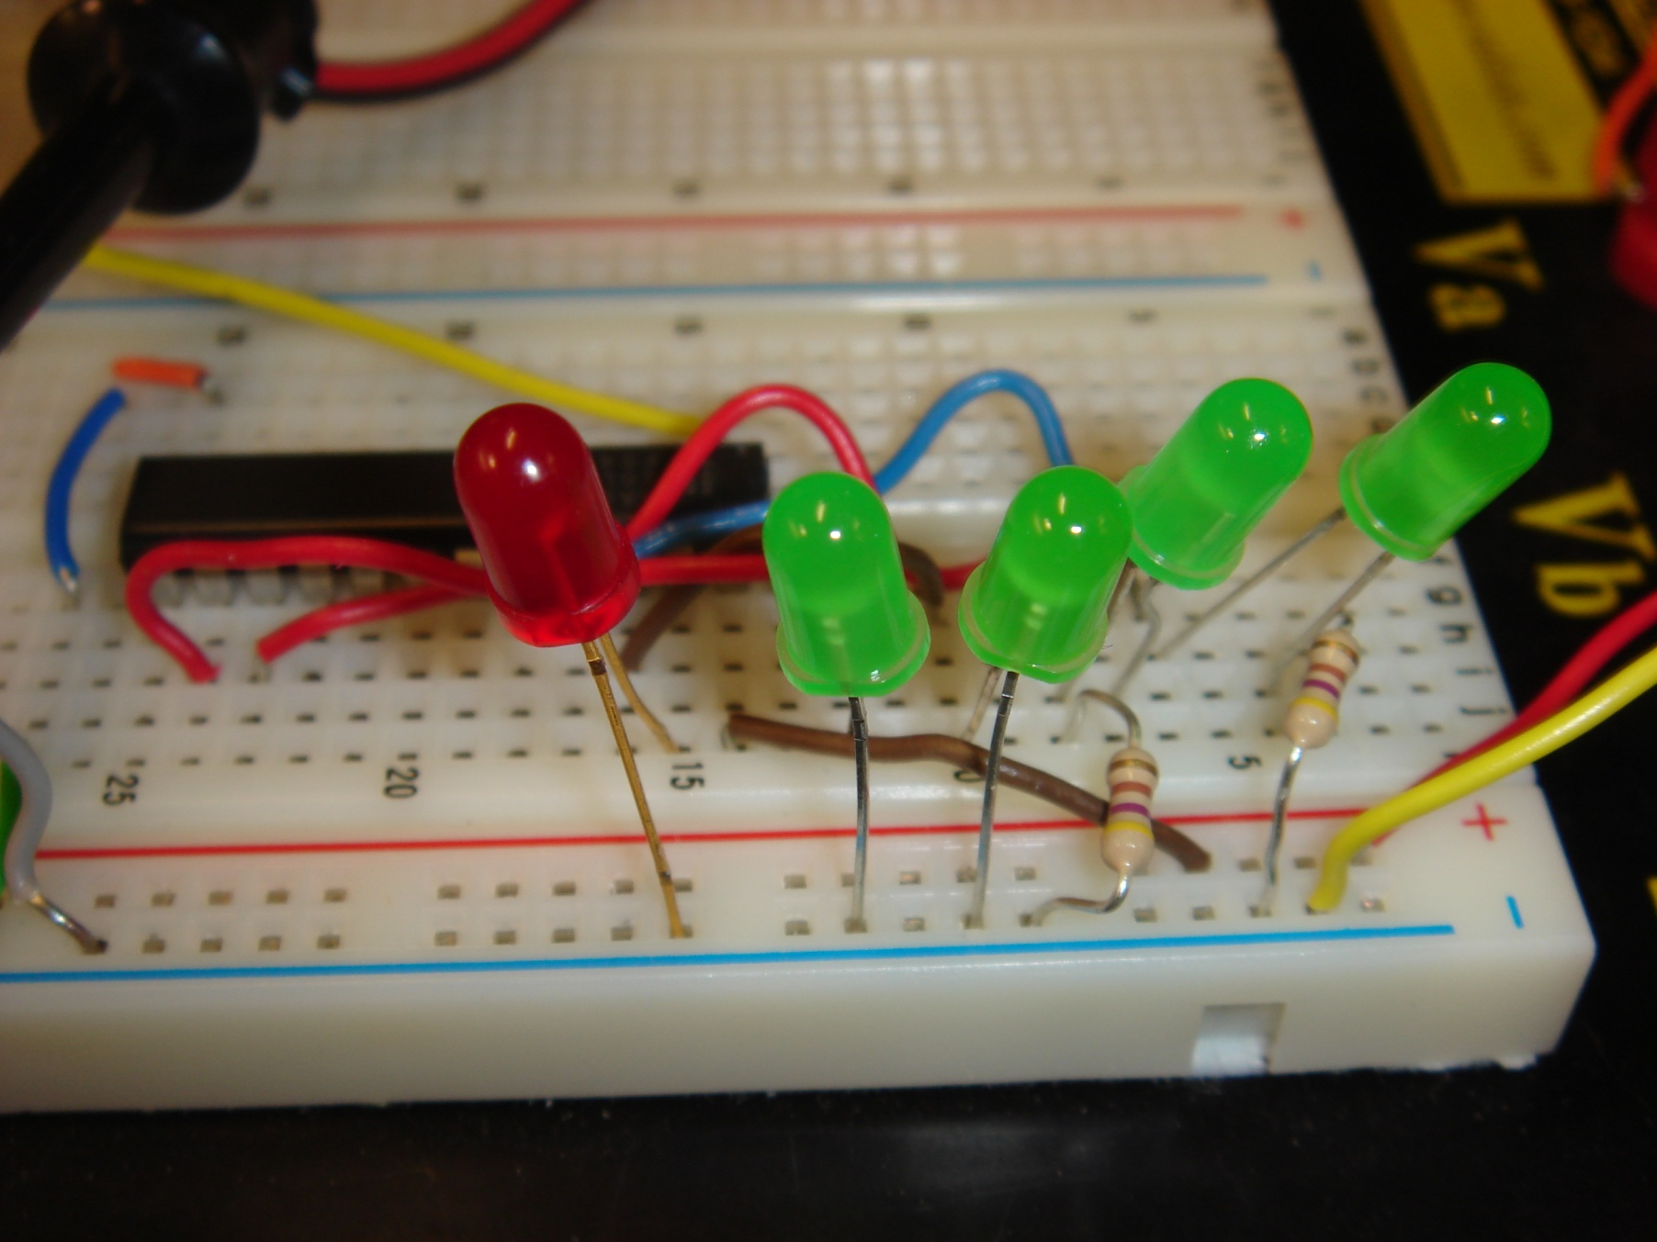
Hardware

Slide 26
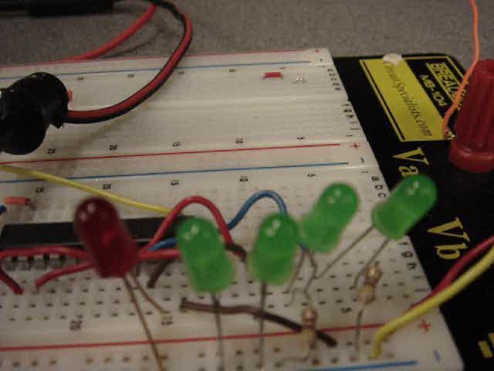
Testing
Notes:
Click on picture to play video.

Slide 27

Question???

Slide 28
Reference
http://en.wikipedia.org/wiki/Fibonacci_number
http://www.latticesemi.com/lit/docs/tutorials/tutor8.pdf?jsessionid=f030ed9e982587c56bcc4864136a29666571
Notes:
http://en.wikipedia.org/wiki/Fibonacci_number

Slide 29
Fibonacci Team Member
Torn Saelee
George Thao

